Slide 1

XML-to-JSON
Converter Service
Scalable • Distributed • Cloud-Native
Yolanda • Lilian • Yuhao
Parser Team Project

Slide 2




Project Overview
The Problem
The Solution
Legacy DevOps tools (Jenkins, Maven) produce XML logs.
High-performance conversion service.
Running on Kubernetes (EKS).
Modern monitoring systems (ELK, Loki) require JSON.
Integrated with AWS (S3, SQS).
Gap: Inefficient observability pipelines.
Notes:
Many DevOps tools (Jenkins, JUnit, Maven, Jacoco) produce XML logs, while modern monitoring systems (ELK, Grafana Loki) require JSON. This project bridges that gap with a high-performance, distributed conversion service running on Kubernetes with AWS integration.

Slide 3
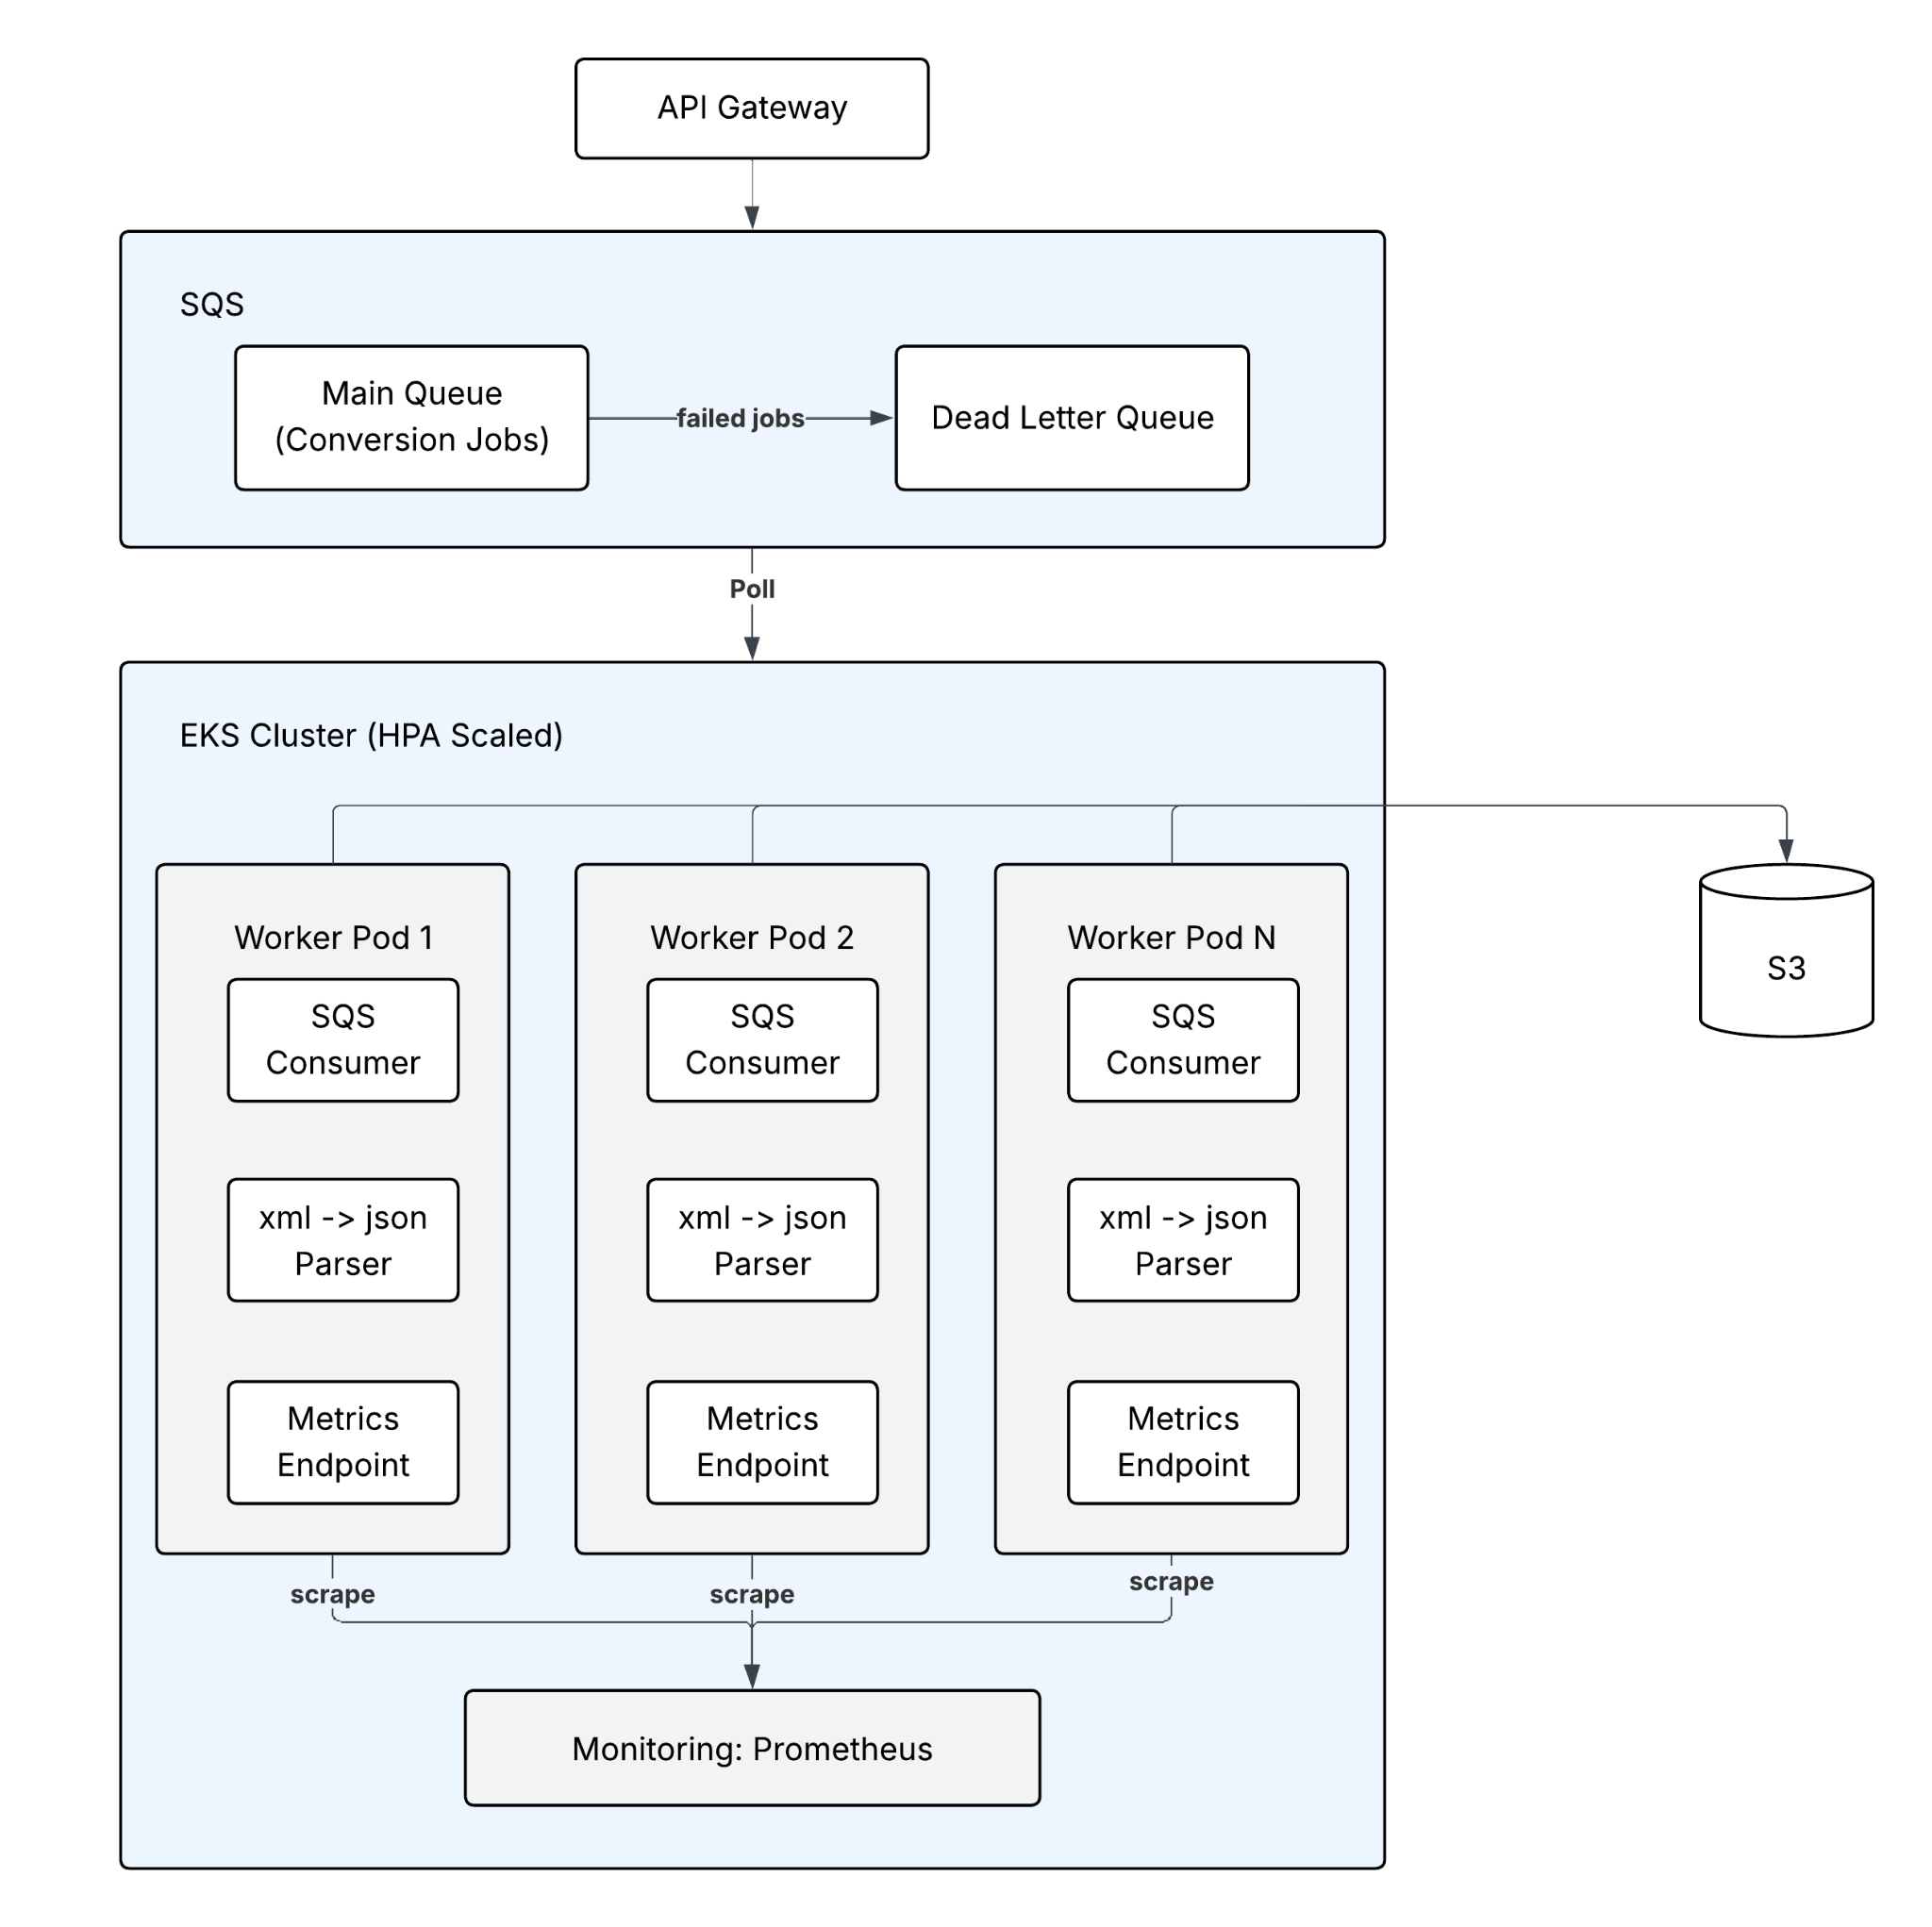
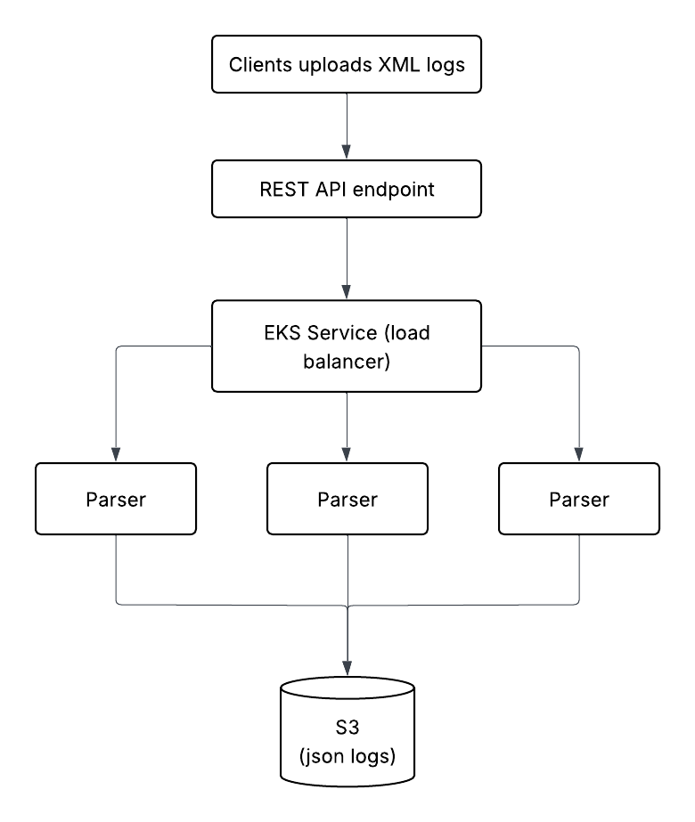
System Architecture
Notes:
The architecture evolved from an initial synchronous RESTful design—where clients submitted jobs through an API Gateway to a load-balanced set of parsers with results stored directly in S3—to a highly scalable, decoupled microservices architecture. The final design utilizes SQS (Simple Queue Service) to buffer jobs, enhancing stability and fault tolerance. This asynchronous pattern employs an EKS Cluster running Worker Pods that consume the SQS queue, perform the XML-to-JSON conversion, and store results in S3. Critical to scalability and health is the integration of Prometheus Monitoring, which scrapes metrics from each worker's endpoint, enabling the Horizontal Pod Autoscaler (HPA) to elastically scale the worker fleet based on real-time load. This transition effectively isolates the failure domains, ensuring the system maintains high availability and superior scaling capabilities.

Slide 4
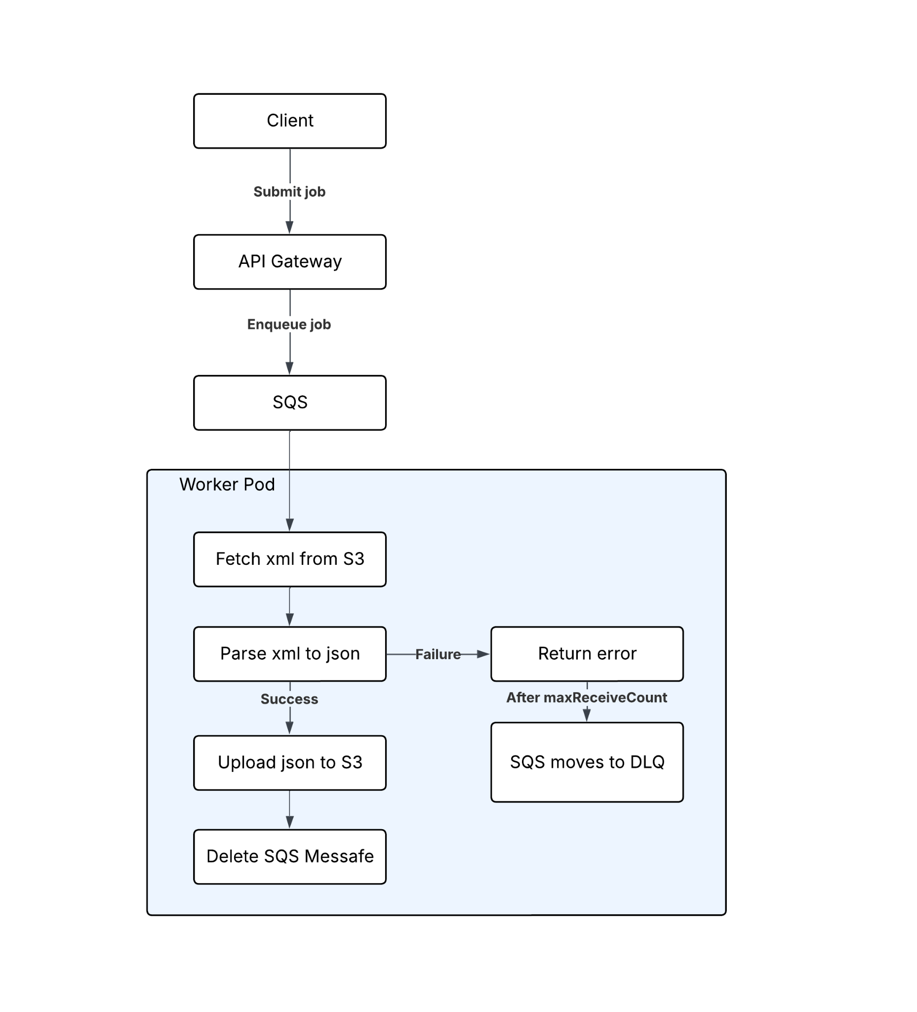
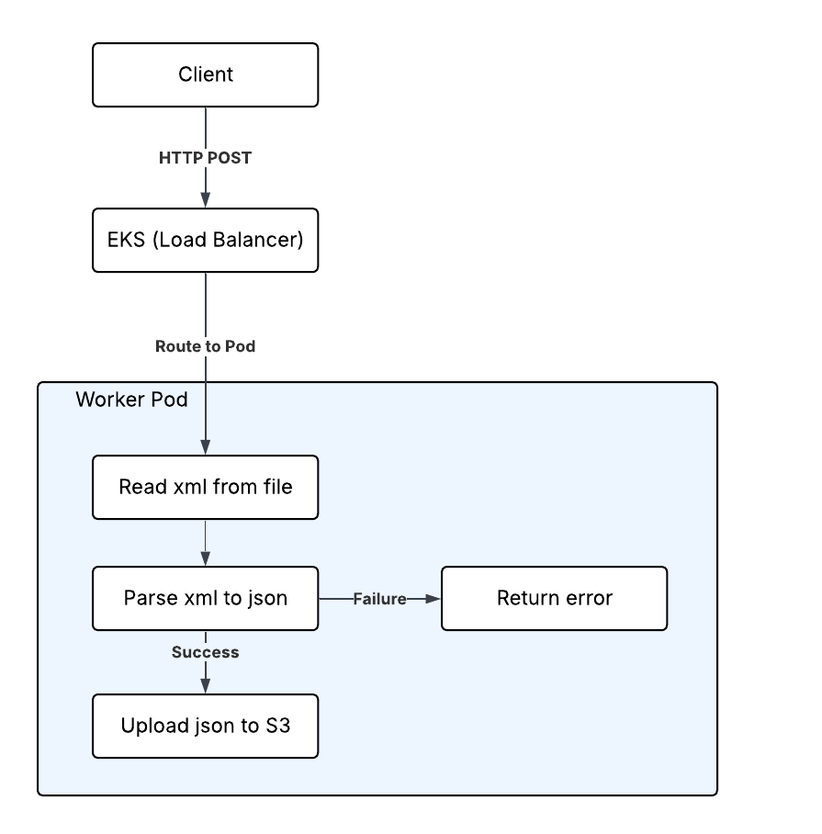
Data Flow Chart
Notes:
The architecture fundamentally evolved from an initial synchronous, load-balanced RESTful design—where clients directly routed XML logs to a simple set of Parser instances for immediate conversion and S3 storage—to a highly scalable, decoupled microservices architecture. This transition introduced an SQS Main Queue to buffer and manage conversion jobs, significantly improving stability and resilience. In the final state, the EKS Cluster runs horizontally auto-scaled Worker Pods that asynchronously poll the queue, perform the conversion, and store results in S3

Slide 5
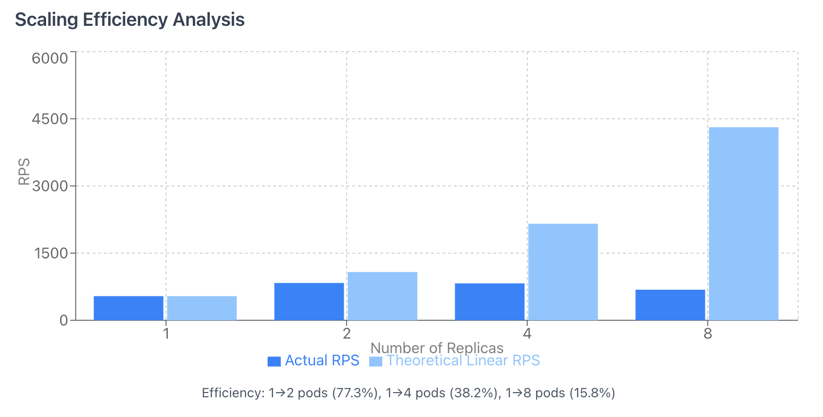
Exp 1: Horizontal Scalability
Purpose
Measure throughput (RPS) and latency scaling limits.
Method
•
Platform: AWS EKS
•
Scaling: 1 → 2 → 4 → 8 Pods
•
Load Tool: Locust (HTTP POST)
•
Metrics: RPS, p95 Latency, CPU
Notes:
1. Purpose
The goal of this experiment is to measure how the XML-to-JSON conversion service scales as more replicas (pods) are added.
We examine how throughput (RPS), latency, and CPU usage change when increasing the number of parser pods, and what scalability limits emerge.
2. Method
We deployed the service on EKS and varied the number of parser pods:
1 → 2 → 4 → 8 pods
Each configuration was tested using Locust, sending high-concurrency HTTP POST requests with XML payloads.
Metrics collected (via Prometheus / Locust):
1.Requests per second (RPS)
2.Average latency
3.p95 latency
4.CPU utilization
5.Request failures
6.Each test was run 3 times and averaged.

Slide 6
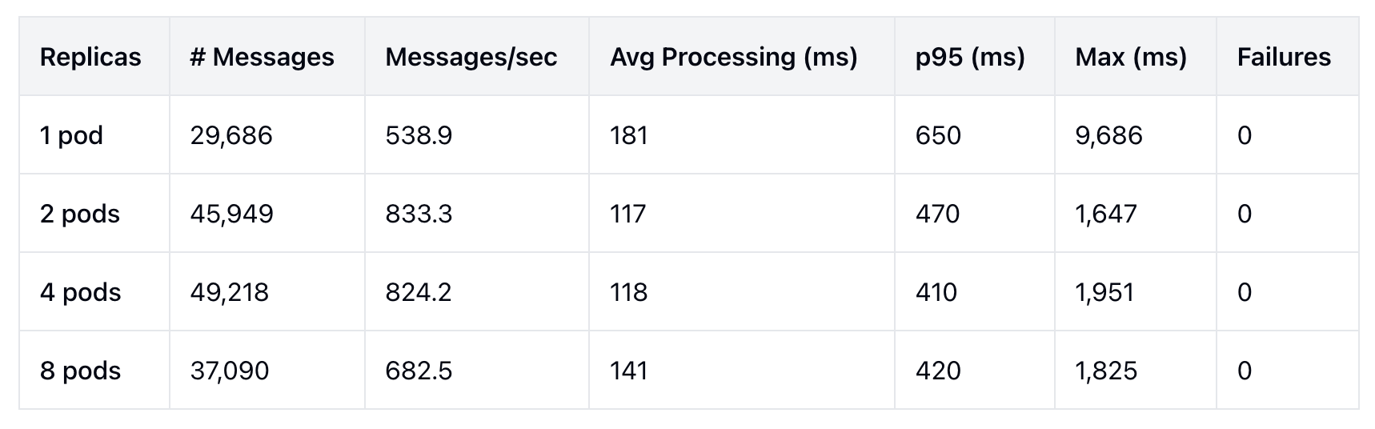
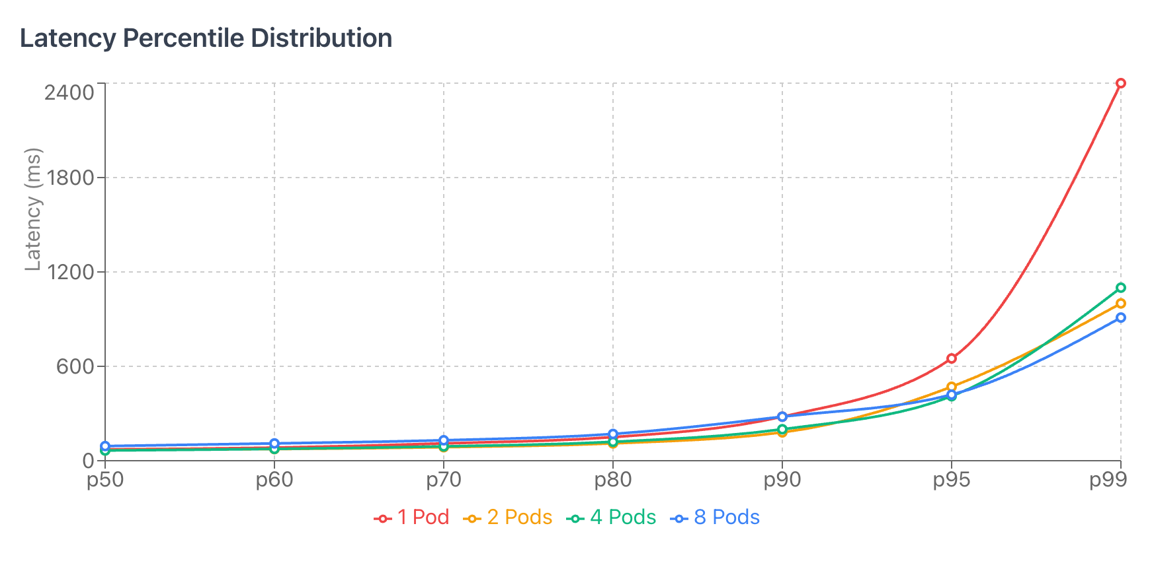
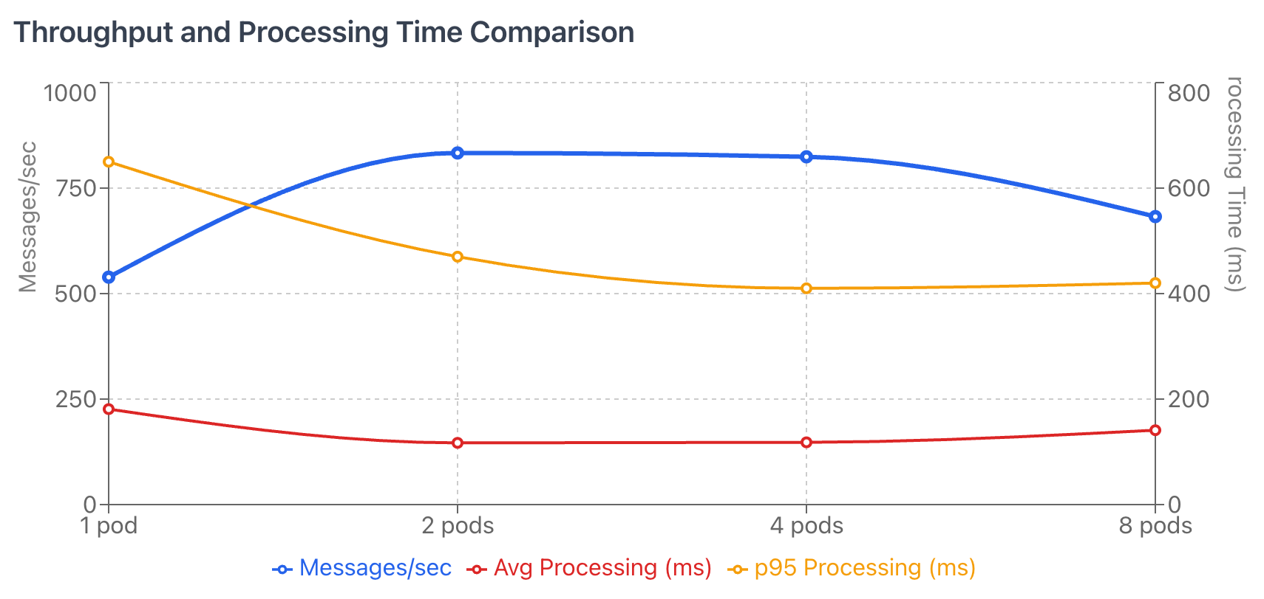
Exp 1 Results
Notes:
Observations: No failures across 161,943 requests. CPU utilization scaled proportionally until 4 pods; at 8 pods CPU per pod dropped, suggesting external bottlenecks.

Slide 7
Exp 1 Analysis
Parallel Efficiency: 1 → 2 pods saw +55% throughput increase.
Optimal Scale: Peak performance achieved at 2-4 pods (~830 RPS).
Diminishing Returns: 8 pods caused performance regression.
Bottleneck Identified: External I/O (S3 writes) or Network saturation, not CPU.
Notes:
1 → 2 pods:
Throughput rose from ~539 messages/sec to ~833 messages/sec (+55%)
Average processing time dropped from 181 ms to 117 ms, and p95 fell from 650 ms to 470 ms — strong evidence of parallel efficiency
2 → 4 pods:
Throughput remained almost constant (~833 → 824 messages/sec), indicating the system reached near-optimal scaling
p95 processing time decreased slightly (470 → 410 ms), showing marginal tail-latency improvement
4 → 8 pods:
Throughput decreased (~824 → 682 messages/sec) and processing time increased (118 → 141 ms, p95 410 → 420 ms)
Suggests a resource or I/O bottleneck (e.g., S3 writes, network saturation, or CPU contention on shared nodes)
System stability: 0 failures across 161,943 requests, confirming robust service operation under load

Slide 8
Exp 2: Elasticity
Test Phases (1000 msg/s Burst)
Baseline
Burst
10 msg/s
1000 msg/s
Medium Load
Scale Down
100 msg/s
Recovery
Notes:
In this experiment, we wanted to see how quickly our system can react when traffic suddenly increases.
We tested four phases: a baseline at 10 messages per second, a medium load at 100, a burst of 1000 messages per second, and finally the recovery period where traffic drops again.

Slide 9
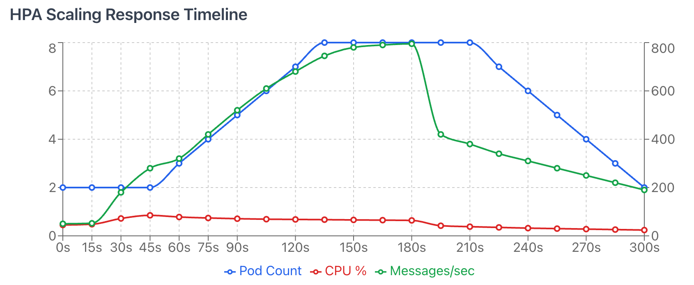
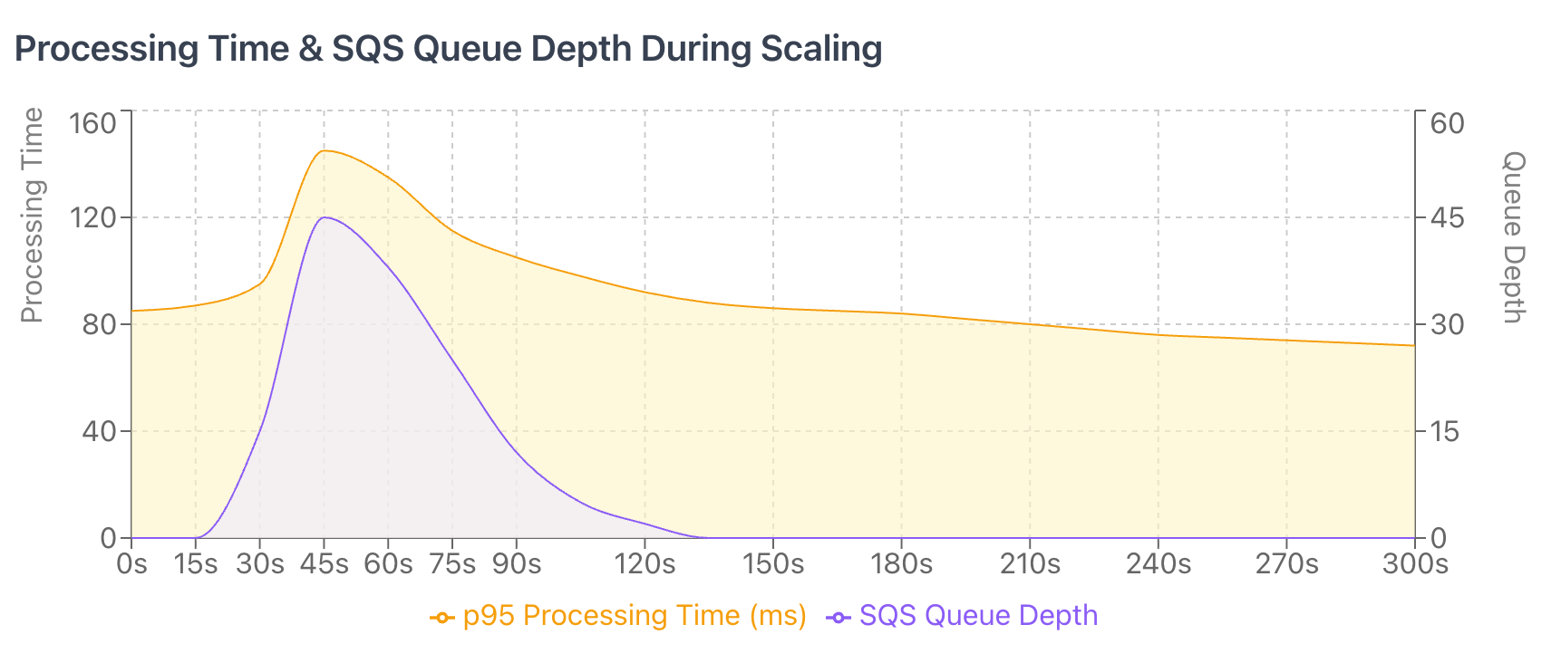
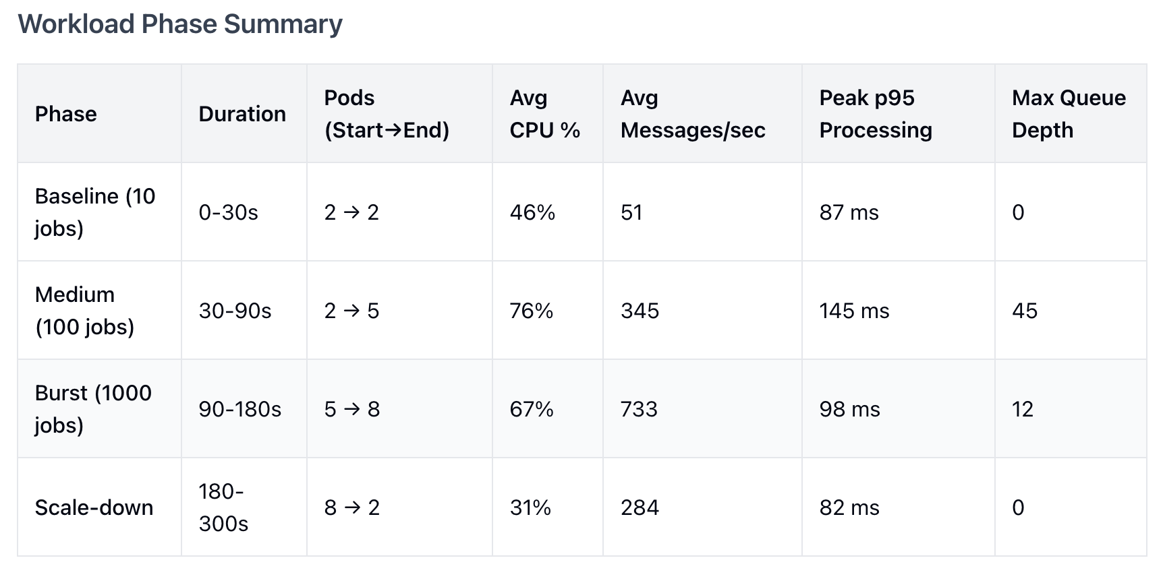
Exp 2 Results: Scaling Response
Rapid Scale-Up:
Pods increased 2 → 8 during burst.
Queue Mgmt:
Peaked at 45 msgs, cleared by 135s.
Stable Latency:
p95 stabilized at ≈85ms after initial spike.
Notes:
From the first chart we can see how the system reacts during the burst.
At the start, only two pods are running. When the load increases, CPU rises above the HPA target, and the system scales up to eight pods.
The queue briefly spikes to around 45 messages, but the workers clear it by about 135 seconds.
We also see that p95 processing time spikes once during the burst, and then stabilizes around 85 milliseconds.
From the second chart we see the relationship between processing time and queue depth.
When the burst begins, both curves rise quickly, which is expected.
But as new pods come online, queue depth drops and processing time returns to normal.
This confirms that HPA prevents long-term congestion in the system.
This table summarizes all phases.
In medium load, pods grow from 2 to 5, and during the burst, they reach 8.
After the burst ends, the system scales down smoothly with no oscillation.

Slide 10


Exp 2 Analysis
Successes
Limitations
HPA prevented long-term backlog.
CPU is an indirect load signal.
Balanced throughput vs. resource cost.
Recommendation: Use KEDA for queue-depth based autoscaling for faster reaction.
Smooth scale-down (no oscillation).
Notes:
In terms of successes, HPA prevented a long backlog and kept latency under control.
Scale-down was smooth, and the system stayed stable throughout the test.
However, CPU is an indirect signal — it reacts slower than queue depth.
A better approach would be queue-based autoscaling, for example using KEDA, which could react even faster to sudden bursts.In terms of successes, HPA prevented a long backlog and kept latency under control.

Slide 11


Exp 3: Fault Tolerance
Scenario 1: Malformed XML
Scenario 2: S3 Outage
Scenario 3: 7/8 Pods Dropped
Notes:
The goal of Experiment 3 is to understand how the system behaves when failures happen.
We test three scenarios: malformed XML input, an S3 outage, and losing most of our worker pods.
For each scenario, we want to see whether the system isolates the error, continues running, and recovers properly.

Slide 12
Exp 3 Results: Malformed XML Input
Scenario 1: Malformed XML
987 (98.7%) bad messages detected & moved to DLQ.
0 Pod crashes.
Clean Isolation: Parsing failures did not cascade.
Notes:
This scenario tests what happens when workers receive invalid XML.
The risk here is that one bad message might crash the worker or block other jobs.
The diagram on the right shows the full flow.
Workers pull a message from SQS, fetch the XML from S3, and try to parse it.
When the XML is malformed, the worker immediately returns an error.
It does not retry endlessly or crash.
After the message hits the maxReceiveCount configured in SQS, the queue automatically moves it to the DLQ.

Slide 13
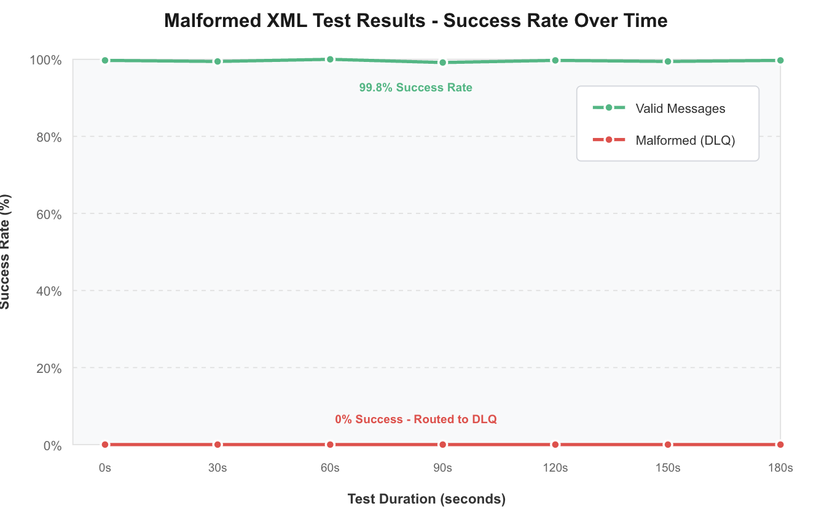
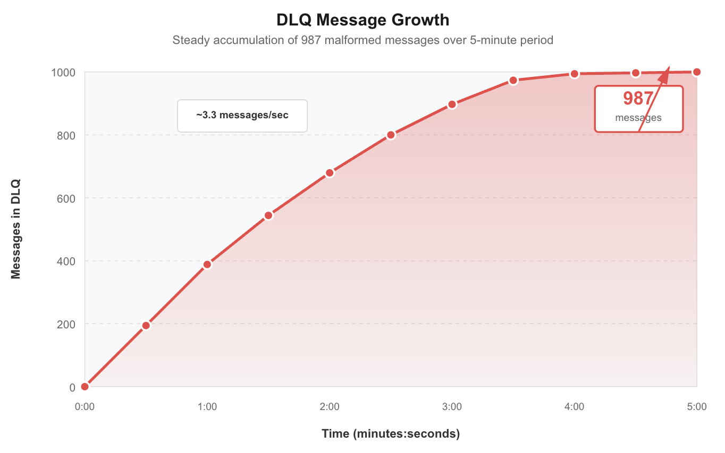
Exp 3 Results: Malformed XML Input
Notes:
During this test, workers pulled messages from SQS as usual, attempted to parse them, and immediately detected that the XML structure was invalid.
Instead of retrying endlessly or crashing, each worker returned an error once, and SQS automatically moved the message to the DLQ after exceeding the retry limit.
In total, 987 malformed messages were routed to the DLQ, and no pods crashed or restarted.
Valid messages continued to be processed normally, confirming that parsing failures are fully isolated.
One improvement we could add is richer DLQ metadata — for example, tagging each failed message with the exact parsing error — so operators can quickly identify bad input sources.

Slide 14
Exp 3 Results: S3 Service Outage
Scenario 2: S3 Outage
97.9% conversion success during outage.
0 Data Loss (Retried via SQS).
Self-Healing: Backlog drained in 28s after recovery.
Notes:
Scenario 2 focuses on what happens when our downstream S3 storage becomes unavailable.
Here, we intentionally removed S3 IAM permissions for two minutes to simulate a real outage. During that time, our conversion pipeline kept running as normal — the only failures were on the upload step.”

Slide 15
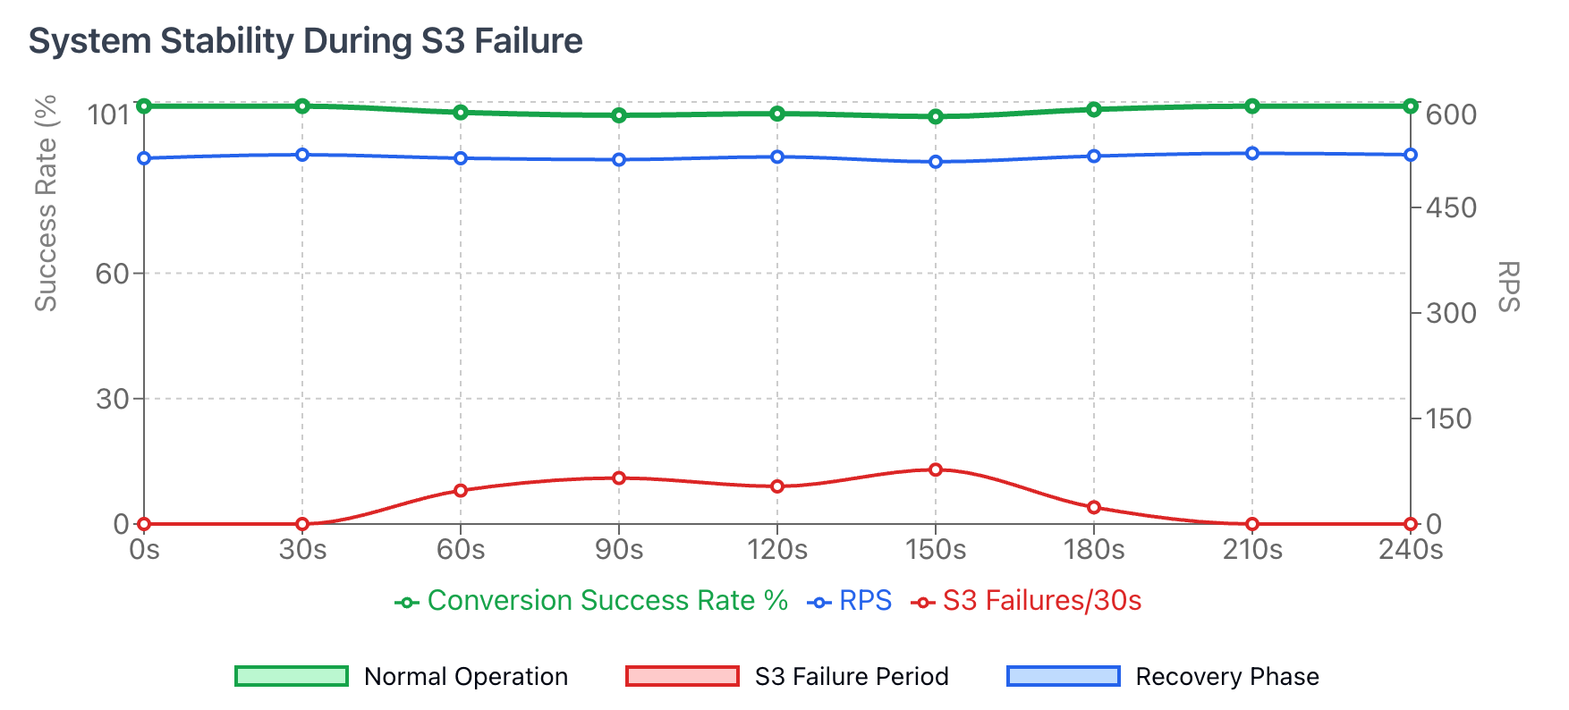
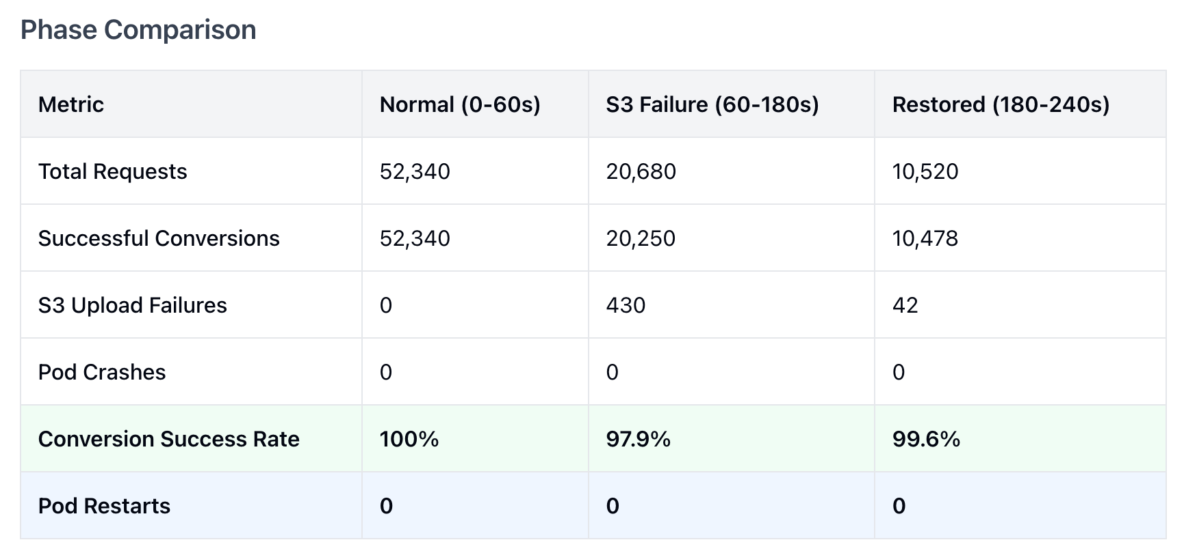
Exp 3 Results: S3 Service Outage
Notes:
“As we can see in results, thanks to SQS’s visibility timeout, no data was lost — failed messages simply re-entered the queue and were retried once S3 recovered.
Even during the outage window, we still achieved 97.9% conversion success, had zero pod crashes, and no data loss.
And once S3 access was restored, the backlog drained in just 28 seconds, showing strong self-healing behavior.”

Slide 16




Future improvements: S3 Service Outage
Circuit-breaker
Extend visibility timeout
Avoid wasting cycles
Tolerate longer disruptions
Notes:
“To make this even more robust, we recommend adding a circuit-breaker around S3, which Detect consecutive S3 failures and temporarily pause upload attempts while continuing XML parsing, then periodically test S3 health to avoid wasted retry cycles
We can also extend the visibility timeout or add local buffering so the system can safely tolerate disruptions longer than two minutes.”

Slide 17
Exp 3 Results: EKS Pods Drop
Scenario 3: 7/8 Pods Dropped
Throughput: Dropped 824 → 103 msg/s.
Queue Spike: 12 → 4,847 messages.
Recovery: 240s to scale back up.
Verdict: Slow but Data Safe (0 Loss).
Notes:
“The next scenario explores a more extreme failure: what happens if most of our compute disappears suddenly.
We manually terminated 7 out of 8 worker pods at t=60, while load stayed at 800 messages per second.
Throughput dropped from 824 to 103 msg/s, and queue depth spiked to about 4,800 messages — but again, no messages were lost, and the one surviving pod continued processing.”

Slide 18
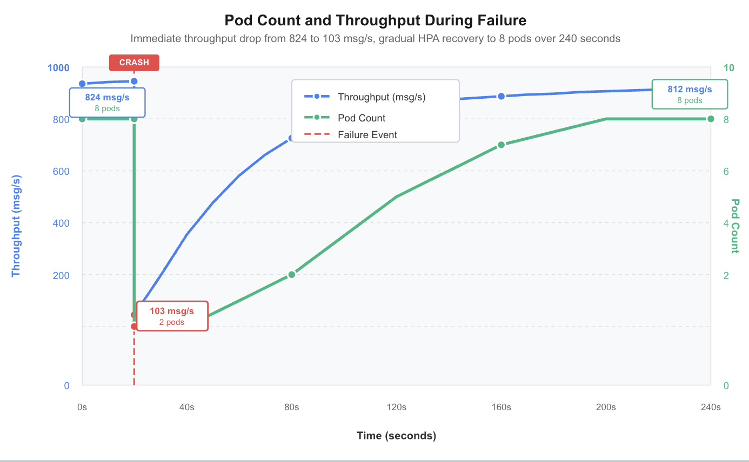
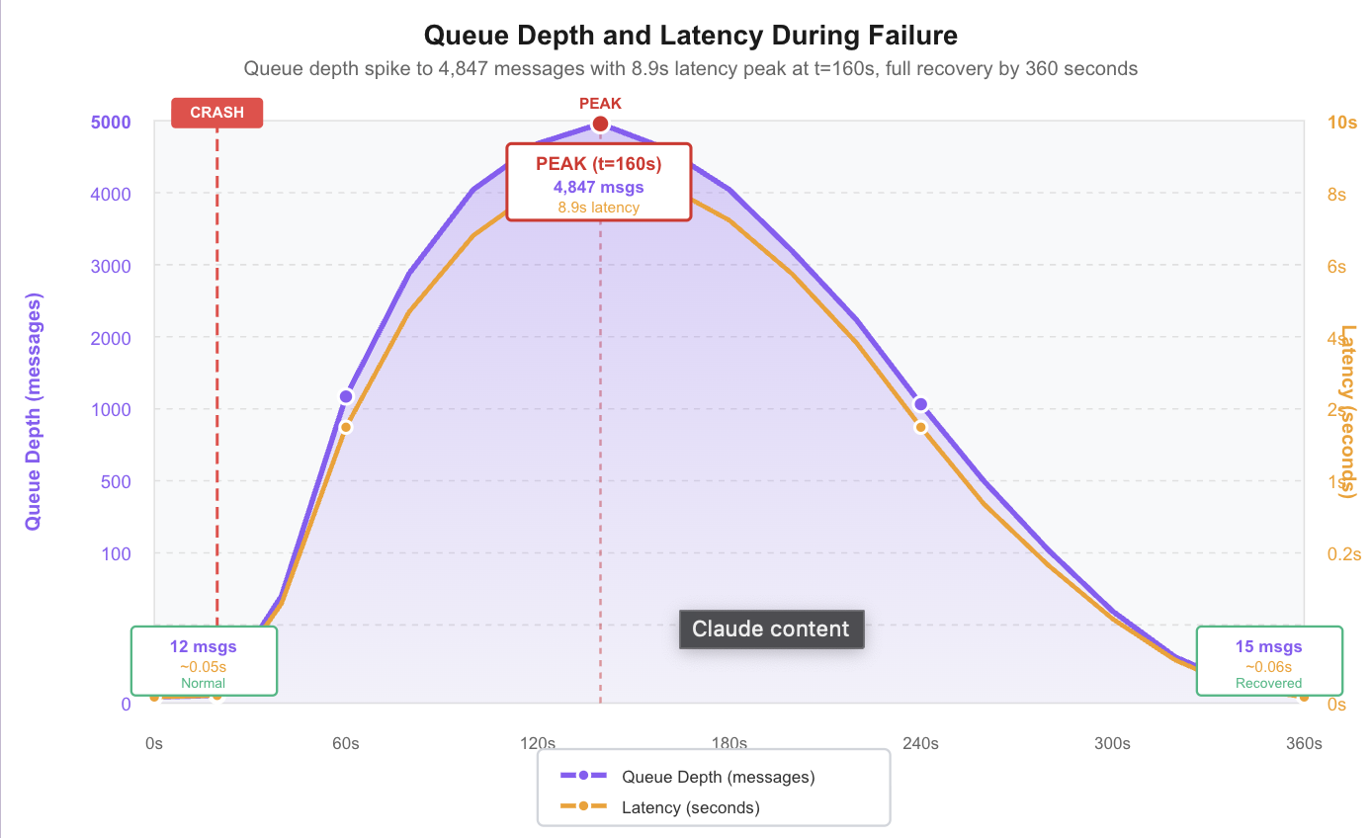
Exp 3 Results: EKS Pods Drop
Notes:
“The main limitation we found is recovery speed.
Because CPU-based HPA reacts slowly, it took around 240 seconds for the system to scale back up to full capacity.
During that time, both latency and queue depth remained high.”
To address this, we could potentially switching from CPU-based HPA to KEDA (Kubernetes event-driven auto-scaling) using queue depth as the scaling signal. This would allow pods to scale before queues explode and reduce recovery time from 240 seconds down to roughly 45 seconds

Slide 19

Resilience Analysis
SQS as Buffer: 5-minute visibility timeout saved messages.
Zero Data Loss: Messages were retried, not dropped.
Rapid Recovery: Backlog drained immediately upon S3 restoration.
Notes:
“Across all scenarios, the system showed consistent resilience.
SQS’s visibility timeout acted as a reliable buffer, ensuring zero data loss even when downstream dependencies failed or when most pods were terminated.
Once the failing component recovered, the system drained backlogs quickly.”

Slide 20






Conclusion
Scalable
Elastic
Resilient
Validated up to ~830 RPS.
Handles 100x burst loads.
Tolerates downstream failure.
Notes:
“To conclude, our service is:
Scalable, validated up to ~830 RPS,
Elastic, handling burst loads up to 100×, and
Resilient, tolerating downstream failures and severe pod crashes with no data loss.
With improvements like KEDA for queue-depth-based auto scaling and a circuit-breaker for S3, we can make recovery even faster and more efficient.”

Slide 21
Q & A
Questions？

